Slide 1
MUSING
Developed By
Nilesh Kumar
Sai Lasya
Aishwarya Namballa

Slide 2
AIM:
One stop website for all the music fans out there where they can find lyrics of any song, information about that song, top 10 songs of their favourite artists and listen to any song that pertains to their mood

Slide 3
Problem Statement:
Today’s users generally have to browse through different sites to meet their varying music needs. It is generally gruelling and time consuming.

Slide 4
Solution:
This website pertains to the various needs of the users ranging from finding the lyrics of a particular song to finding information about the song, Whether they want to know the top songs of their favourite artists or want to listen to any song that suits their mood, this website covers it all.

Slide 5
TECHNOLOGY USED
HTML
CSS
Javascript

Slide 6
API USED
Youtube Data API
The Audio Db
Lyrics.ohv

Slide 7
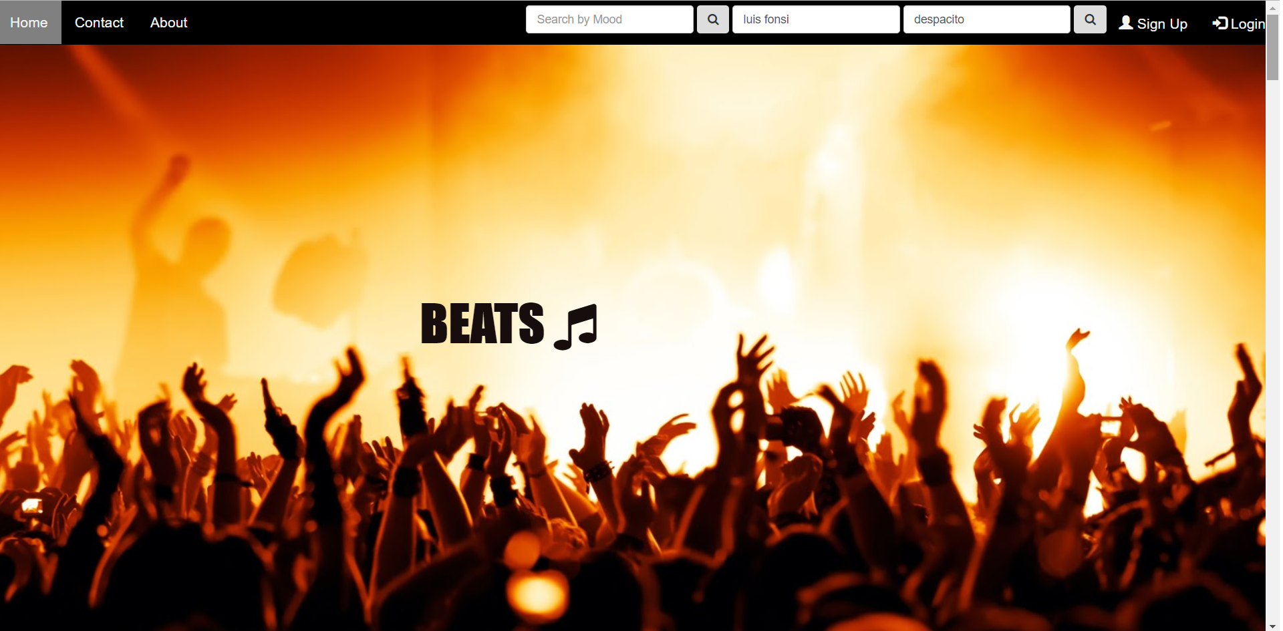
THE COVER PAGE

Slide 8
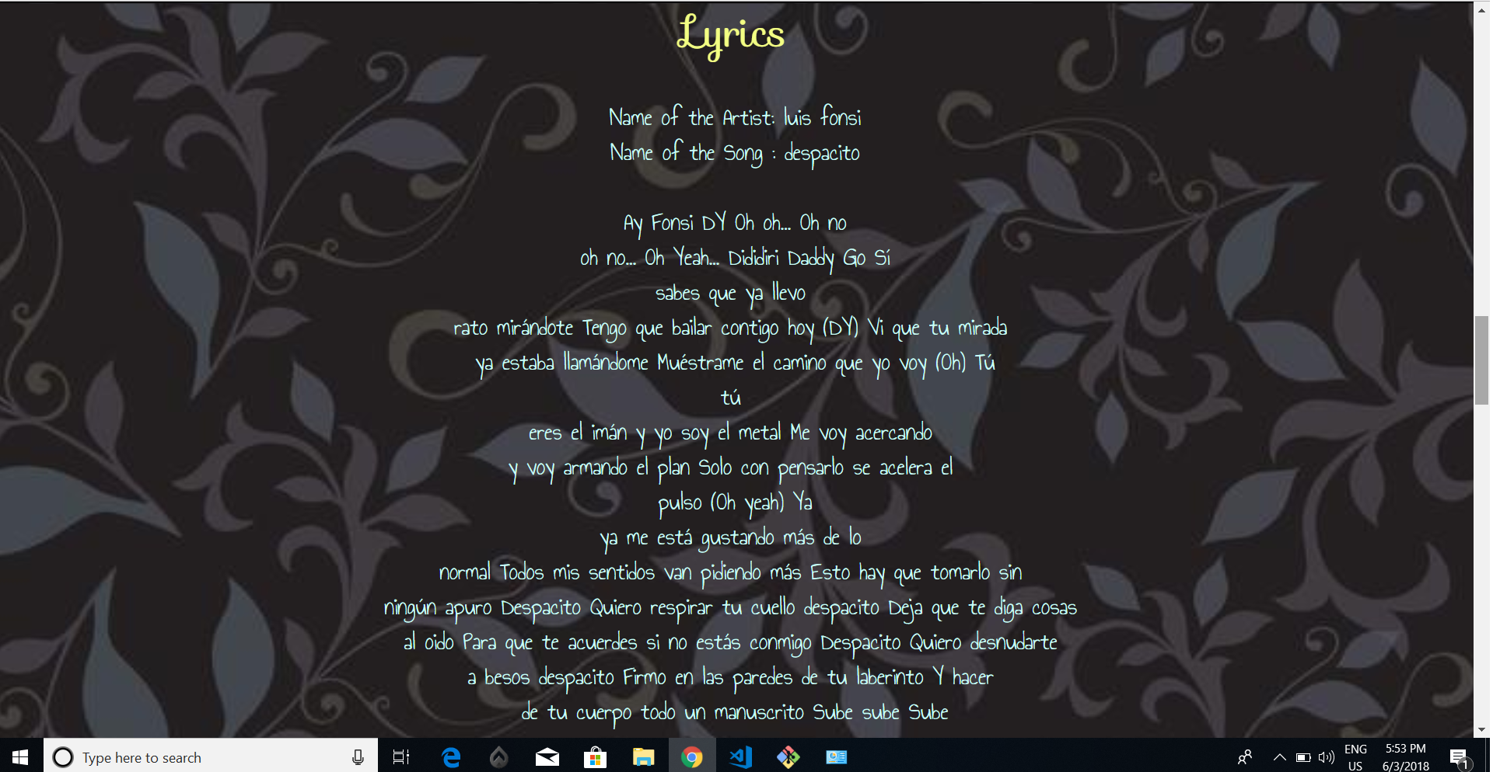

Slide 9
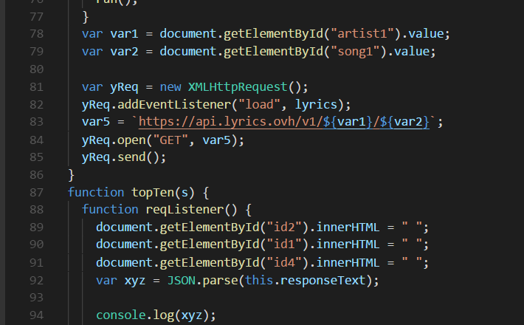

Slide 10
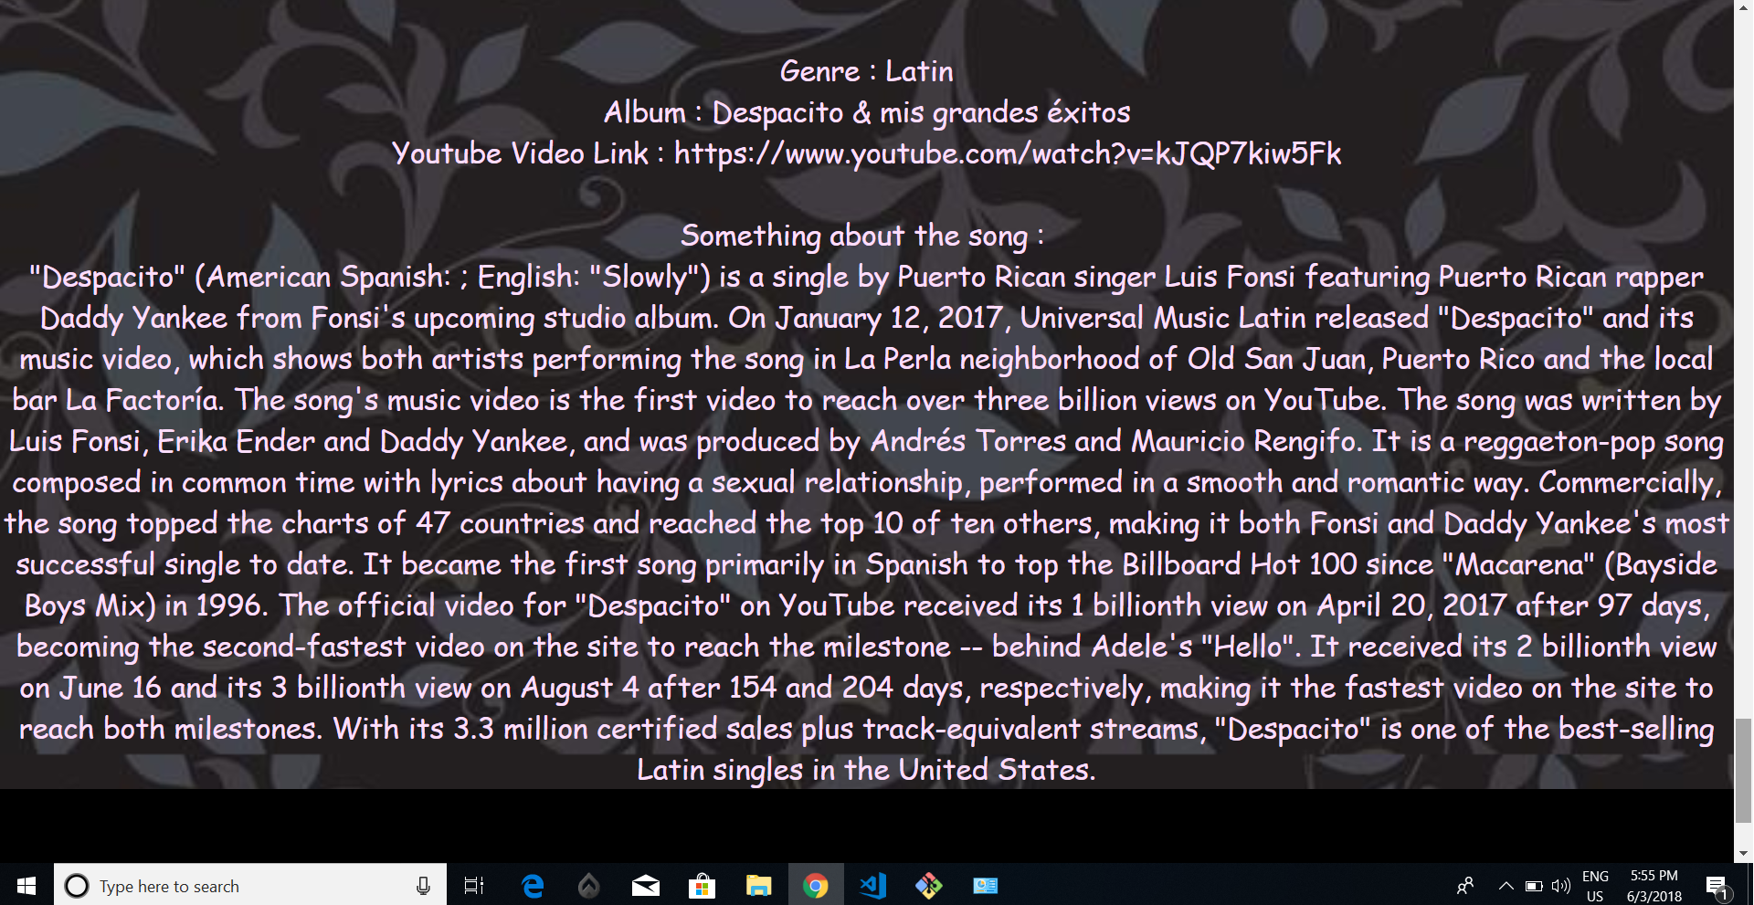

Slide 11
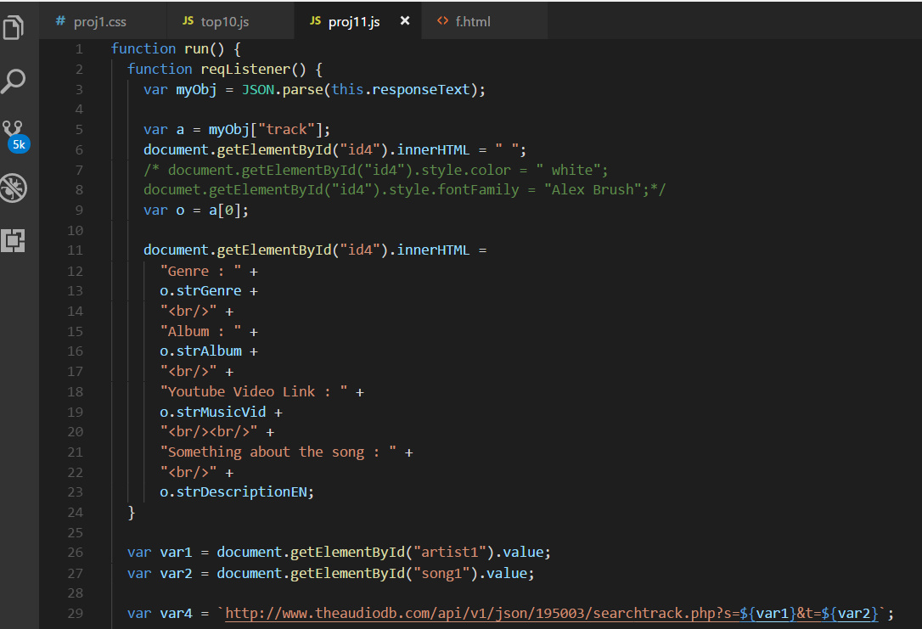

Slide 12
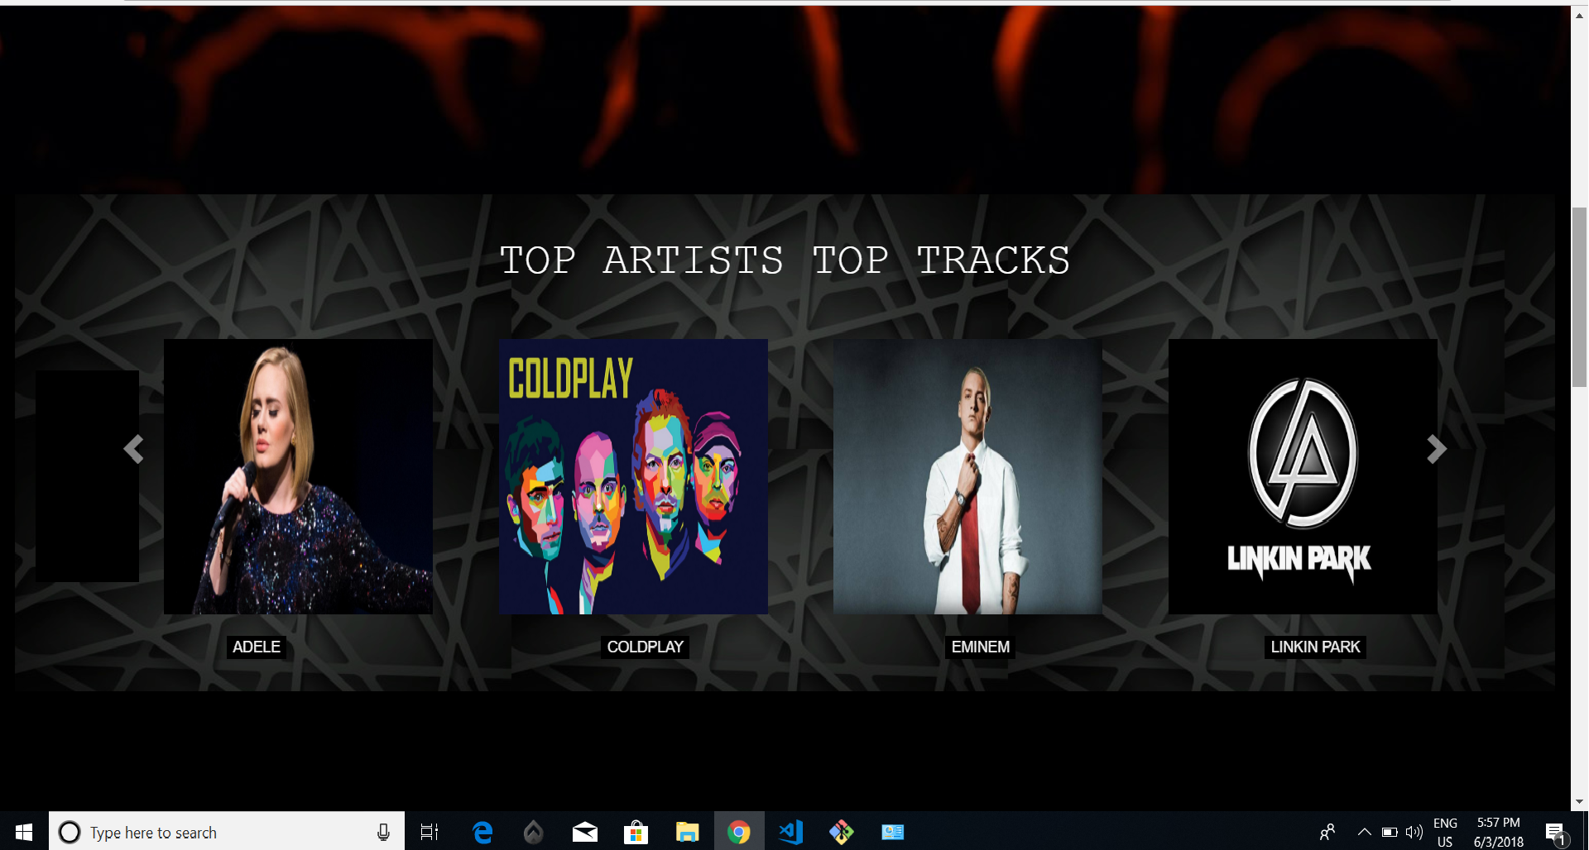

Slide 13
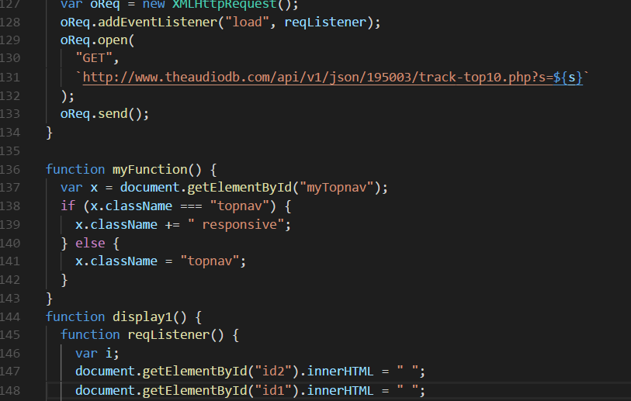

Slide 14
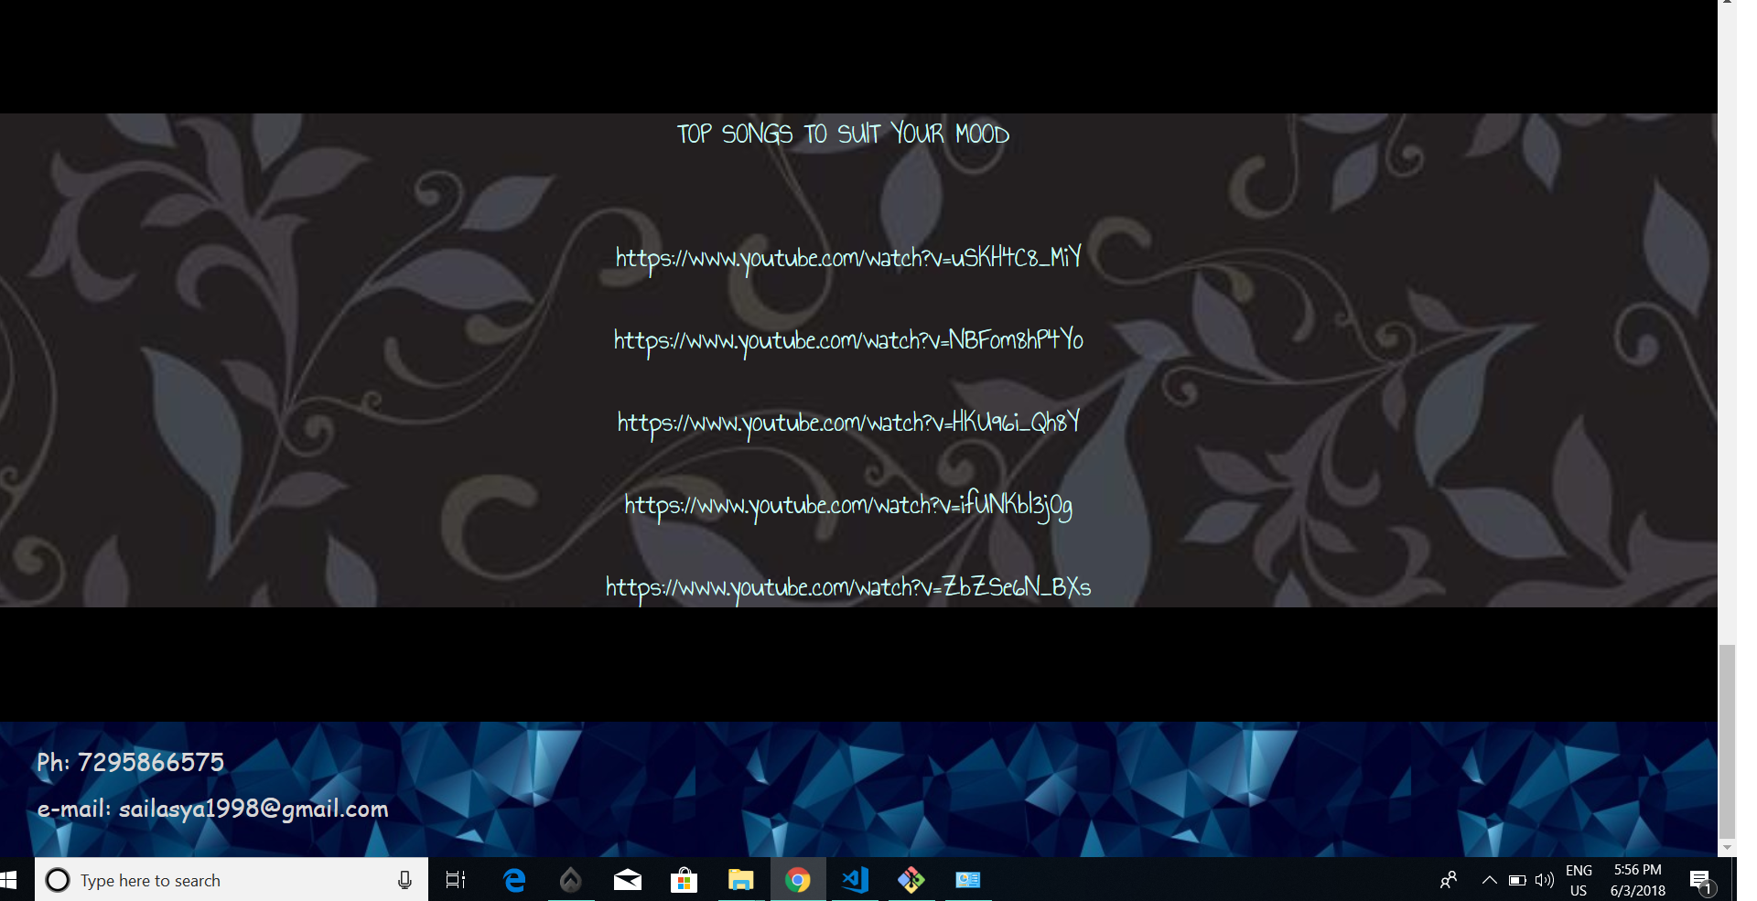

Slide 15
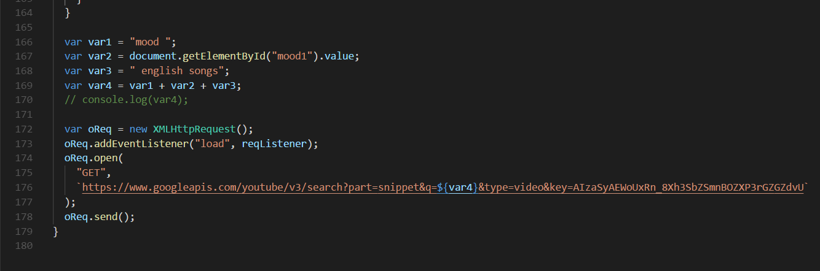

Slide 16
Future plans
Song recommendation system according to frequent searches.
Favourite songs column according to frequent searches of user.
Expanding the app such that users who listen to songs of different languages can use it.
Backend and Database Creation.

